Slide 1
Vorlesung Netzwerksicherheit
Sommersemester 2022
Mo. 14-16 Uhr

Slide 2
Internet Routing - Inhalte
Geschichte des Internets
ARPANet
NSFNet
„Das Internet“
Internet Protocol
Wie Alice und Bob über das Internet kommunizieren
Netzwerk von Netzwerken (Autonome Systeme)
Netzwerk-Routing Protokolle
Border Gateway Protocol
Notes:
What today‘s lecture is about (Topic today: Internet Routing)
First, i would like to give a brief overview about the history of the Internet
It all began with the ARPANet, followed by the NSFSNet which led into the Internet as we know it today
Second, a short introduction or brush up (depending on your knowledge) about the Internet Protocol
Third, we are going to have a closer look how Alice and Bob might communicate utilizing the Internet.
Right after that a view on the technical structure of the Internet will be presented and how packet routing in networks work.
The brush-up then ends with the Border Gateway Protocol.

Slide 3
Die Entstehung des Internets
„The ARPANet was the first transcontinental, high-speed computer network.“ -- (Eric S. Raymond, author and software developer)

Slide 4
Die Entstehung des Internets – Teil 1
ARPANet (Advanced Research Projects Agency Network)
Erste Forschung begann bereits im Jahre 1963.
Schon 1969 führte das ARPANet TCP/IP Netzwerk-Protokolle ein.
Notes:
The ARPA (currently named DARPA for Defense Advanced Research Projects Agency) is a military research agency in the US.
On this map you see computers serially connected to IMPs (Interface Message Processors) that are interconnected via gateways.
The dial-in happens via MODEM providing data rates about 50kbit/s.
The map is not cropped so this is the whole ARPANet.

Slide 5
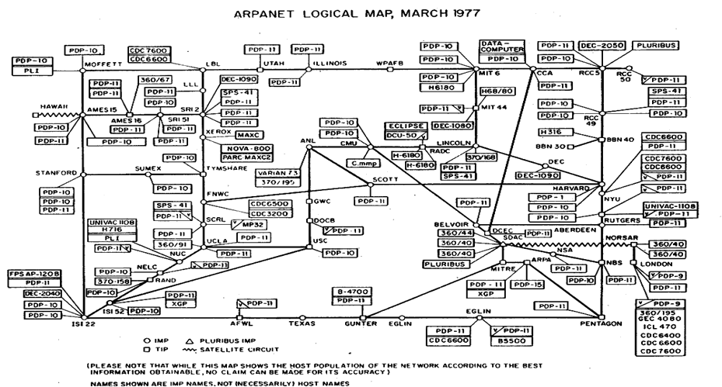
Die Entstehung des Internets – Teil 1
ARPANet (Advanced Research Projects Agency Network)
Erste Forschung begann bereits im Jahre 1963.
Schon 1969 führte das ARPANet TCP/IP Netzwerk-Protokolle ein.
Image ©
The Computer
History Museum
Notes:
The ARPA (currently named DARPA for Defense Advanced Research Projects Agency) is a military research agency in the US.
On this map you see computers serially connected to IMPs (Interface Message Processors) that are interconnected via gateways.
The dial-in happens via MODEM providing data rates about 50kbit/s.
The map is not cropped so this is the whole ARPANet.

Slide 6
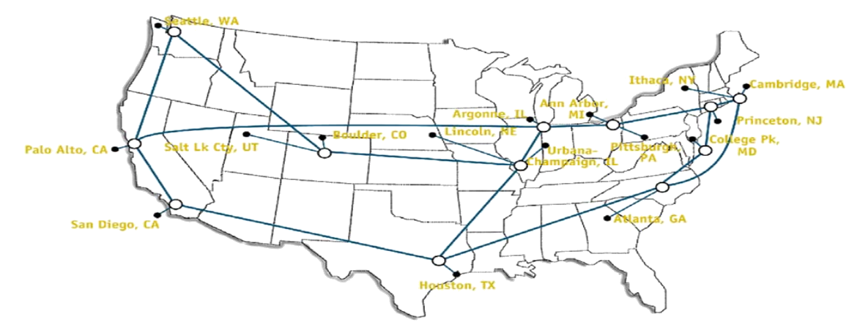
Die Entstehung des Internets – Teil 2
NSFNet (National Science Foundation Network)
Folgte dem ARPANet 1985 und wurde 1995 vom Internet abgelöst
Übertragungsgeschwindigkeiten wuchsen von 56 Kbit/s bis auf 45 Mbit/s
Traditionelle Dienste:
E-Mail
News
Remote login
File transfer
Notes:
About 15 years later, the National Science Foundation Network came into place.
It spanned the whole US and connected different university places and research institutes.
In the time between 1985 and 1995 the data rate increased from 56kbit/s up to 45 Mbit/s.
Services have been established, such as E-Mail (which is still in place today), News (does anyone still knows NNTP in here?)
Also Remote login and File Transfer (FTP) have been invented.
NSFNet T1 Network from wikipedia
Facts: http://www.merit.edu/about/history/pdf/NSFNET_final.pdf
Traditional Services from Tanenbaum (slideset)

Slide 7

















Die Entstehung des Internets – Teil 3
mobile network
Das Internet verbindet heute Millionen von Endgeräten miteinander.
Endnutzer und Unternehmen bezahlen Internet Service Provider (ISPs), um Zugang zum Internet zu erhalten.
Service Provider und große Unternehmen (z.B. Google, Microsoft, etc.) betreiben eigene Wide Area Networks („Autonome Systeme“).
AS sind paarweise miteinander verbunden und bilden mit all diesen Verbindungen den Internet-Backbone.
global ISP
home
network
regional ISP
institutional
network
Image ©
J.F. Kurose & K. W. Ross
(Book: Computer Networking)
Notes:
Today: wired, wireless, cellular, network providers and more.
Millions ofdevices: this laptop, all your mobile phones, cars, microwaves, fridges
How do you connect your devices to the Internet?
Mainly, you lease Internet connections from an Internet Service Provider (e.g. Deutsche Telekom, One And One, Netcologne)
They run a large customer network that itself is connected to further ISPs to provide internetworking connections.
Larger Companies (such as Google, Microsoft) and universities like the University of Bonn operate larger networks on their own.
When integrated in to the internet, a network is called autonomous system (which means that each AS is operated under a single authoritative domain).
The interconnection of all these ASes build the Internet backbone.
In order to let computers communicate, communication protocols are necessary. Thus, …
Image from Kurose Ross Slide-Deck

Slide 8
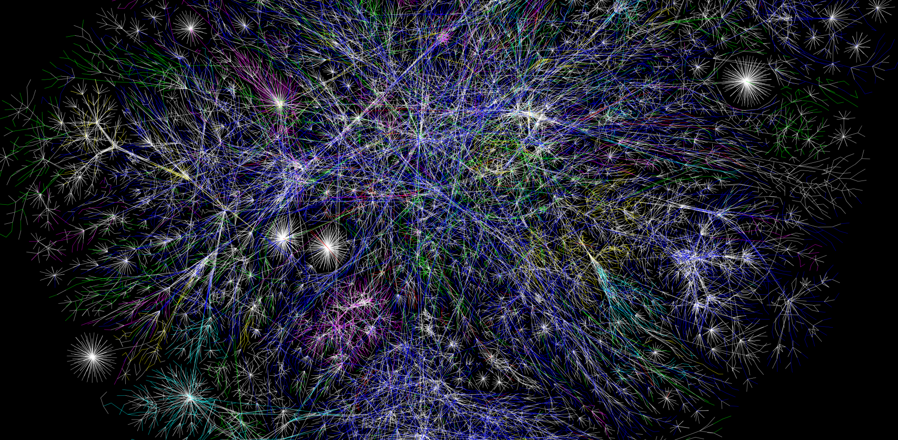
Eine Landkarte des Internets?
Teil einer Karte des Internets am 15. Januar 2005, gefunden auf opte.org

Slide 9
Internet Routing - Inhalte
Geschichte des Internets
ARPANet
NSFNet
„Das Internet“
Internet Protocol
Wie Alice und Bob über das Internet kommunizieren
Netzwerk von Netzwerken (Autonome Systeme)
Netzwerk-Routing Protokolle
Border Gateway Protocol
Notes:
What today‘s lecture is about (Topic today: Internet Routing)
First, i would like to give a brief overview about the history of the Internet
It all began with the ARPANet, followed by the NSFSNet which led into the Internet as we know it today
Second, a short introduction or brush up (depending on your knowledge) about the Internet Protocol
Third, we are going to have a closer look how Alice and Bob might communicate utilizing the Internet.
Right after that a view on the technical structure of the Internet will be presented and how packet routing in networks work.
The brush-up then ends with the Border Gateway Protocol.

Slide 10
Internet-Protokolle - Definition
Ein Protokoll definiert das Format und die Reihenfolge von Nachrichten, die zwischen zwei oder mehr kommunizierenden Einheiten ausgetauscht werden, sowie die Handlungen, die bei der Übertragung und/oder beim Empfang einer Nachricht oder eines anderen Ereignisses unternommen werden.
J.F. Kurose & K. W. Ross
(Book: Computer Networking)
Notes:
… the Internet Protocols need to be defined.
Protocols define…
And how are protocols used in the Internet?
Has anyone ever heard ISO/OSI or TCP/IP?
From Kurose Ross Slide-Deck

Slide 11
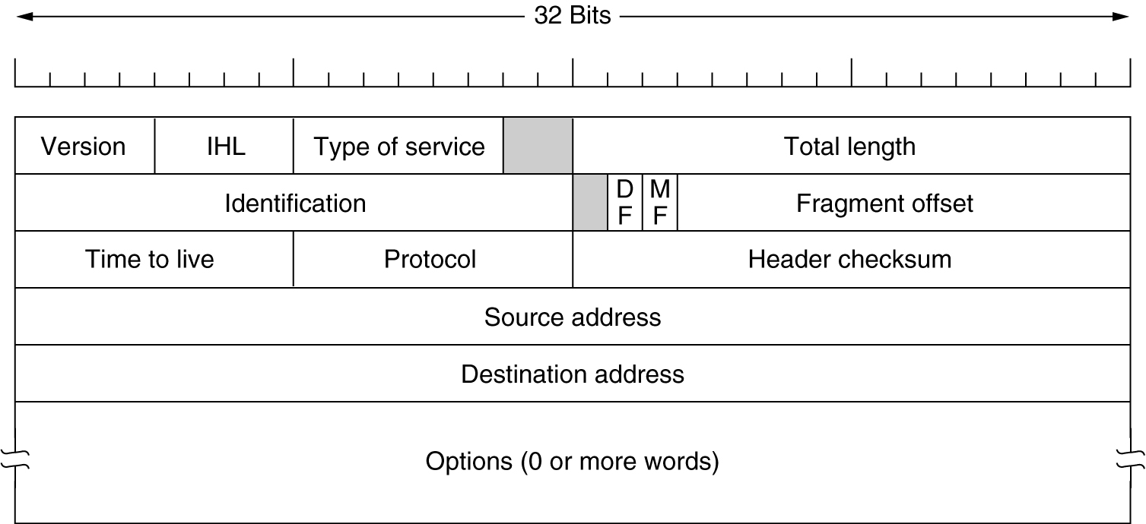
Das Internet-Protokoll
Internet Protocol (Layer 3, Network/Internet) Version 4
Notes:
So, the most important protocol for the Internet is IP.
This is an image of the IP version 4 datagram format.
Imagine a computer with just one process, IP is feasible to let computers communicate via the IP address.
Before we talk about addressing, let us go through the header fields:
Version: as already mentioned, this one has a value for the 4th version of IP.
IHL provided the IP header length (as you can see that there is a variable length option field).
Type of Service can be used to identify the payload data and ensure quality of service.
Total length is the size of the whole datagram including payload of the upper layer. (16 bit => up to 64kbyte per datagram)
Identification and fragment offset allow fragmentation of IP datagrams (this may happen because underlying layers may only support smaller fragments / frames for ethernet for example, which is limited to 1500 bytes.
The TTL value reverse counts the number of routers this packet may visit before it expires (which results in a drop and data loss).
Protocol defines the upper layer protocol (which is tcp = 6 or udp = 17).
Header checksum simply contains a chesum over all header fields (and as the quick people here already see, it has to be computed on every router because of the updated TTL)
So, in order to identify sender and receiver of a datagram, the source and destination address are used.
Image from Tanenbaum slides

Slide 12
Das Internet-Protokoll
Internet Protocol (Layer 3, Network/Internet) Version 4
Identifiziert den Sender eines IP-Datenpakets
Identifiziert den Empfänger eines IP-Datenpakets
Notes:
… those are 32 bit values in version 4 (which is not enough for all the connected devices nowadays) and 128 bit values in the following IPv6.
Image from Tanenbaum slides

Slide 13
Internet Routing - Inhalte
Geschichte des Internets
ARPANet
NSFNet
„Das Internet“
Internet Protocol
Wie Alice und Bob über das Internet kommunizieren
Netzwerk von Netzwerken (Autonome Systeme)
Netzwerk-Routing Protokolle
Border Gateway Protocol
Notes:
What today‘s lecture is about (Topic today: Internet Routing)
First, i would like to give a brief overview about the history of the Internet
It all began with the ARPANet, followed by the NSFSNet which led into the Internet as we know it today
Second, a short introduction or brush up (depending on your knowledge) about the Internet Protocol
Third, we are going to have a closer look how Alice and Bob might communicate utilizing the Internet.
Right after that a view on the technical structure of the Internet will be presented and how packet routing in networks work.
The brush-up then ends with the Border Gateway Protocol.

Slide 14


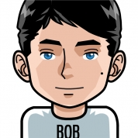
Internet-Kommunikation
Wie Alice und Bob über das Internet kommunizieren
Angenommen, es gibt eine direkte Verbindung zwischen dem ISP von Alice und dem von Bob
Accessnet
(ISP)
Accessnet
(ISP)
131.220.240.100
74.100.129.53
Alice and Bob images from http://wikis.zum.de/rmg/Benutzer:Deininger_Matthias/Facharbeit/Alice_Bob_und_Mallory
Notes:
Imagine a tiny version of the Internet…
Images from http://wikis.zum.de/rmg/Benutzer:Deininger_Matthias/Facharbeit/Alice_Bob_und_Mallory

Slide 15
Internet-Kommunikation
Wie Alice und Bob über das Internet kommunizieren
Angenommen, es gibt keine direkte Verbindung zwischen dem ISP von Alice und dem von Bob
Accessnet
(ISP)
access
net
Accessnet
(ISP)
access
net
access
net
131.220.240.100
74.100.129.53
Notes:
Assume that the Internet is a bit larger than assumed before.
Alice and Bob images from http://wikis.zum.de/rmg/Benutzer:Deininger_Matthias/Facharbeit/Alice_Bob_und_Mallory
Accessnet from Kurose Ross Chapter 1 slide 33.

Slide 16
Internet Routing - Inhalte
Geschichte des Internets
ARPANet
NSFNet
„Das Internet“
Internet Protocol
Wie Alice und Bob über das Internet kommunizieren
Netzwerk von Netzwerken (Autonome Systeme)
Netzwerk-Routing Protokolle
Border Gateway Protocol
Notes:
What today‘s lecture is about (Topic today: Internet Routing)
First, i would like to give a brief overview about the history of the Internet
It all began with the ARPANet, followed by the NSFSNet which led into the Internet as we know it today
Second, a short introduction or brush up (depending on your knowledge) about the Internet Protocol
Third, we are going to have a closer look how Alice and Bob might communicate utilizing the Internet.
Right after that a view on the technical structure of the Internet will be presented and how packet routing in networks work.
The brush-up then ends with the Border Gateway Protocol.

Slide 17




Netzwerk von Netzwerken
…
…
access
net
access
net
access
net
access
net
access
net
access
net
access
net
…
…
access
net
access
net
access
net
access
net
access
net
Credits to
J.F. Kurose & K. W. Ross
(Book: Computer Networking)
…
access
net
access
net
access
net
…
access
net
Notes:
See many instances of alice and bob and their access net provider, how do think they might be interconnected?

Slide 18
Netzwerk von Netzwerken – Der naive Ansatz
…
…
access
net
access
net
access
net
access
net
access
net
…
…
access
net
access
net
…
Direkte Verbindungen aller ISPs untereinander skaliert nicht: O(N²) Verbindungen
…
…
access
net
access
net
…
access
net
access
net
access
net
Credits to
J.F. Kurose & K. W. Ross
(Book: Computer Networking)
…
…
access
net
access
net
access
net
…
access
net
Notes:
Well, connecting all of them directly won‘t work well as it leads to O(N to the power of 2) connections
Images from Kurose Ross slide 34

Slide 19
Netzwerk von Netzwerken – Schritt 1
…
…
access
net
access
net
access
net
access
net
access
net
access
net
access
net
…
…
global ISP
access
net
access
net
access
net
Wenn jeder lokale ISP einen globalen Transit-ISP hätte… Kunde und Provider der ISPs haben einen Provider-Vertrag.
access
net
access
net
Credits to
J.F. Kurose & K. W. Ross
(Book: Computer Networking)
…
access
net
access
net
access
net
…
access
net
Notes:
Images from Kurose Ross slide 35

Slide 20
Netzwerk von Netzwerken – Schritt 2
…
…
access
net
access
net
access
net
access
net
access
net
access
net
access
net
ISP A
…
…
access
net
ISP B
access
net
ISP C
access
net
Wenn man als globaler ISP Geld verdienen kann, dann gibt es auch Mitbewerber …
access
net
access
net
Credits to
J.F. Kurose & K. W. Ross
(Book: Computer Networking)
…
access
net
access
net
access
net
…
access
net
Notes:
Images from Kurose Ross slide 36

Slide 21
Netzwerk von Netzwerken – Schritt 3
…
Internet exchange point
…
access
net
access
net
access
net
access
net
access
net
IXP
access
net
access
net
ISP A
…
…
IXP
access
net
access
net
ISP B
peering link
ISP C
access
net
Wenn man als globaler ISP Geld verdienen kann, dann gibt es auch Mitbewerber …
die jeweils verbunden werden …
access
net
access
net
Credits to
J.F. Kurose & K. W. Ross
(Book: Computer Networking)
…
access
net
access
net
access
net
…
access
net
Notes:
Images from Kurose Ross slide 37

Slide 22
Netzwerk von Netzwerken – Der Letzte Schritt
…
…
access
net
access
net
access
net
access
net
access
net
IXP
access
net
access
net
ISP A
…
…
IXP
access
net
access
net
ISP B
ISP C
access
net
… um Kosten zu sparen, gründen lokale ISPs kleinere regionale ISPs
access
net
access
net
regional net
Credits to
J.F. Kurose & K. W. Ross
(Book: Computer Networking)
…
access
net
access
net
access
net
…
access
net
Notes:
Images from Kurose Ross slide 37

Slide 23
Internet Routing
Also wie kommt jetzt die Nachricht von Bob zu Alice?
…
…
…
…
…
…
131.220.240.100
74.100.129.53

Slide 24
Internet Routing
Also wie kommt jetzt die Nachricht von Bob zu Alice?
…
…
…
…
…
…
131.220.240.100
74.100.129.53

Slide 25
Internet Routing
Also wie kommt jetzt die Nachricht von Bob zu Alice?
…
…
…
…
…
…
131.220.240.100
74.100.129.53

Slide 26
Internet Routing - Inhalte
Geschichte des Internets
ARPANet
NSFNet
„Das Internet“
Internet Protocol
Wie Alice und Bob über das Internet kommunizieren
Netzwerk von Netzwerken (Autonome Systeme)
Netzwerk-Routing Protokolle
Border Gateway Protocol
Notes:
What today‘s lecture is about (Topic today: Internet Routing)
First, i would like to give a brief overview about the history of the Internet
It all began with the ARPANet, followed by the NSFSNet which led into the Internet as we know it today
Second, a short introduction or brush up (depending on your knowledge) about the Internet Protocol
Third, we are going to have a closer look how Alice and Bob might communicate utilizing the Internet.
Right after that a view on the technical structure of the Internet will be presented and how packet routing in networks work.
The brush-up then ends with the Border Gateway Protocol.

Slide 27
Netzwerk-Routing Protokolle - Übersicht
Routing-Protokolle definieren den Austausch von Netzwerk-Erreichbarkeitsinformationen (Network Layer Reachability Information; NLRI)
Link-State und Distanz-/Pfad-Vektor-Protokolle basieren auf einer graphbasierten Repräsentation des Netzwerks
Link-State
Router verwalten die vollständige Topologie und Link-Kosten des gesamten Netzwerks.
Jeder Router berechnet die Pfade mit geringsten Kosten zu allen anderen Knoten.
Dijkstra‘s algorithms
Pfad-Vektor
Jeder Knoten kommuniziert regelmäßig den eigenen Pfad-Vektor an direkt verbundene AS.
Der Empfänger aktualisiert die eigenen Pfad-Vektor-Einträge entsprechend.
Bellman-Ford-Gleichung

Slide 28
Link-State Routing Protocol – Dijkstra‘s Algorithm
Der Algorithmus nach Dijkstra rechnet auf einem Graphen und erstellt eine Weiterleitungstabelle für jeden Knoten
Notation:
c(x,y): Kosten von Knoten x zu y = ∞, wenn nicht direkt verbunden.
D(v): Aktuelle Kosten des Gesamtpfads zu v.
p(v): Vorgängerknoten auf dem Pfad zu v.
N‘: Menge der Knoten, zu denen der günstigte Pfad bekannt ist.
Notes:
Let us have a look on dijkstra‘s algorithm.

Slide 29
Link-State Routing Protocol – Dijkstra‘s Algorithm
Algorithmus:
1: N‘ = {u}
2: for all nodes v
3: if v adjacent to u
4: then D(v) = c(u,v)
5: else D(v) = ∞
6: Loop
7: find w not in N‘ such that D(w) is minimum
8: add w to N‘
9: update D(v) for all v adjacent to w and not in N‘:
10: D(v) = min( D(v), D(w) + c(w,v))
11: if (D(w) + c(w,v)) < D(v): p(v) = w
12: until all nodes in N‘

Slide 30
Dijkstra Algorithmus - Beispiel
D(v)
p(v)
D(w)
p(w)
D(x)
p(x)
D(y)
p(y)
D(z)
p(z)
Step
N'
Example from
J. F. Kurose & K. W. Ross
(Book: Computer Networking)
0
u
7,u
3,u
5,u
∞
∞
1
uw
6,w
5,u
11,w
∞
2
uwx
6,w
11,w
14,x
x
3
uwxv
10,v
14,x
9
4
uwxvy
12,y
7
5
5
uwxvyz
4
notes:
construct shortest path tree by tracing predecessor nodes
ties can exist (can be broken arbitrarily)
8
u
3
w
y
z
2
3
7
4
v
Notes:
Step 0: direct connect to v, w and x, no connection to y, z => add w
Step 1: better path to v via w (cost 6 instead of 7)
new path to y via w => add x (cheaper than path via x)
Step 2: new path to z via x => add v
Step 3: better path to y via v => add y
Step 4: new path to z via y
Step 5: no unrecognized node left

Slide 31
Dijkstra Algorithm – Komplexität und Probleme
Example from
J. F. Kurose & K. W. Ross
(Book: Computer Networking)
Komplexität bei n Knoten:
Jeder Durchlauf: Prüfe alle w, die noch nicht in N’ sind
n(n+1)/2 Vergleiche: O(n²)
Es gibt effizientere Methoden mit kürzerer Laufzeit: O(n log n)
Oszillation möglich:
A
A
A
A
1
1+e
2+e
0
0
2+e
2+e
0
D
0
B
D
B
D
B
D
B
0
1+e
1
0
0
1+e
1
0
C
e
0
C
0
1
C
1+e
0
C
0
1
1
e
given these costs,
find new routing….
resulting in new costs
given these costs,
find new routing….
resulting in new costs
given these costs,
find new routing….
resulting in new costs
initially
Notes:
How complex is such an algorithm? Well, the naive approach (for each iteration) has to check all the nodes which are not in N prime.
This leads to n * n + 1 by 2 comparisons which is in total O(n to the power of 2)
Improved implementation might calculate it in O(n log n)
The dijkstra algorithm can lead to strange situations, where oscillation between two or more possible routes may happen.

Slide 32
Distanz-Vektor Routing Protocol – Bellman Ford Gleichung
Bereits im ARPANet als „RIP“ genutzt
Idee: Dynamische Programmierung
Ansatz:
let
dx(y) := cost of least-cost path from x to y
then
dx(y) := minv { c(x,v) + dv(y) }
Notation:
minv: taken over all neighbors v of x.
c(x,v): cost to neighbor v.
dv(y): cost from neighbor v to node y.
Notes:
For the distance vector protocol which has been used from the beginning of the ARPANet for interdomain routing (RIP = Routing Information Protocol)

Slide 33
Bellman-ForD-Gleichung - Beispiel
5
Offensichtlich: dv(z) = 5, dx(z) = 3, dw(z) = 3
v
3
w
2
5
u
2
z
B-F-Gleichung:
3
1
1
2
du(z) = min { c(u,v) + dv(z),
c(u,x) + dx(z),
c(u,w) + dw(z) }
= min {2 + 5,
1 + 3,
5 + 3} = 4
x
y
1
Der Nachbarknoten mit dem kleinsten Kostenwert wird der
Next-Hop des kürzesten Pfads in der “Forwarding”-Tabelle

Slide 34
Distanz-Vektor Routing Protocol – Bellman-Ford-Gleichung
Dx(y) = geschätzte Kosten von x nach y
x verwaltet Distanz-Vektor Dx = [Dx(y): y ∊ N]
Knoten x
kennt die Kosten zu jedem Nachbarn v: c(x, v)
verwaltet für jeden Nachbarn v einen Distanz-Vektor Dv = [Dv(y): y ∊ N]
Idee:
Jeder Knoten sendet seinen Dx regelmäßig an seine Nachbarn.
Wenn x von seinem Nachbarn einen neuen Distanz-Vektor erhält, aktualisiert er seinen: Dx(y) ← minv{c(x,v) + Dv(y)} for each node y ∊ N.
Normalerweise konvergiert Dx(y) zu den tatsächlich niedrigsten Kosten dx(y).

Slide 35
DistanZ-Vektor - Beispiel
D_{x}(z) = min{c(x,y) + D_{y}(z), c(x,z) + D_{z}(z)}
= min{2+1 , 7+0} = 3
D_{x}(y) = min{c(x,y) + D_{y}(y), c(x,z) + D_{z}(y)}
= min{2+0 , 7+1} = 2
node x
table
cost to
cost to
x y z
x y z
x
0 2 7
x
0
2
3
y
y
from
∞
∞
∞
from
2 0 1
z
∞
∞
∞
z
7 1 0
node y
table
cost to
x y z
y
∞
2 0 1
2
1
x
∞
∞
x
z
y
7
from
z
∞
∞
∞
cost to
node z
table
x y z
x
∞ ∞∞
∞
∞
y
∞
from
z
7
1
0
time

Slide 36
DistanZ-Vektor - Beispiel
D_{x}(z) = min{c(x,y) + D_{y}(z), c(x,z) + D_{z}(z)}
= min{2+1 , 7+0} = 3
D_{x}(y) = min{c(x,y) + D_{y}(y), c(x,z) + D_{z}(y)}
= min{2+0 , 7+1} = 2
node x
table
cost to
cost to
cost to
x y z
x y z
x y z
x
0 2 7
x
0
2
3
x
0 2 3
y
y
from
∞
∞
∞
from
2 0 1
y
2 0 1
z
z
from
∞
∞
∞
7 1 0
z
3 1 0
node y
table
cost to
cost to
cost to
x y z
x y z
x y z
y
2
1
x
∞
∞
x
0 2 7
∞
2 0 1
x
0 2 3
x
z
y
y
7
from
from
2 0 1
y
2 0 1
from
z
∞
∞
∞
z
7 1 0
z
3 1 0
node z
table
cost to
cost to
cost to
x y z
x y z
x y z
x
∞ ∞ ∞
x
0 2 7
x
0 2 3
y
y
2 0 1
y
from
2 0 1
from
from
∞
∞
∞
z
z
z
7
1
0
3 1 0
3 1 0
time
time

Slide 37
DistanZ-Vektor Routing Protocol
Änderungen der Kosten
Knoten erkennt lokales Update der Kosten…
… aktualisiert Erreichbarkeitsinformationen und berechnet neuen Distanz-Vektor für betroffene Ziele…
… und informiert die Nachbarn bei Bedarf.
“Good news travel fast”:
t0 : y erkennt Kostenupdate, aktualisiert eigene DV und informiert Nachbarn.
t1 : z erhält Update von y, aktualisiert seine Tabelle, berechnet neue Kosten zu x und sendet eigenen DV an alle Nachbarn.
t2 : y erhält Update von z, aktualisiert seine Tabelle. Die Kosten für y ändern sich nicht, also sendet y auch keine Nachricht an z.
Notes:
So, how does this approach react on changes of link costs?
Node updates its local link cost and updates its own distance vector for all affected destinations.
Aftwerwards, all connected neighbors are informed of the change and update their own informations accordingly.
This usually happens in a specific amount of time. This depends on increment or decrement of the link cost.
Let us have a look at lowering the cost which leads to „good news travel fast“. So, how does this work?

Slide 38
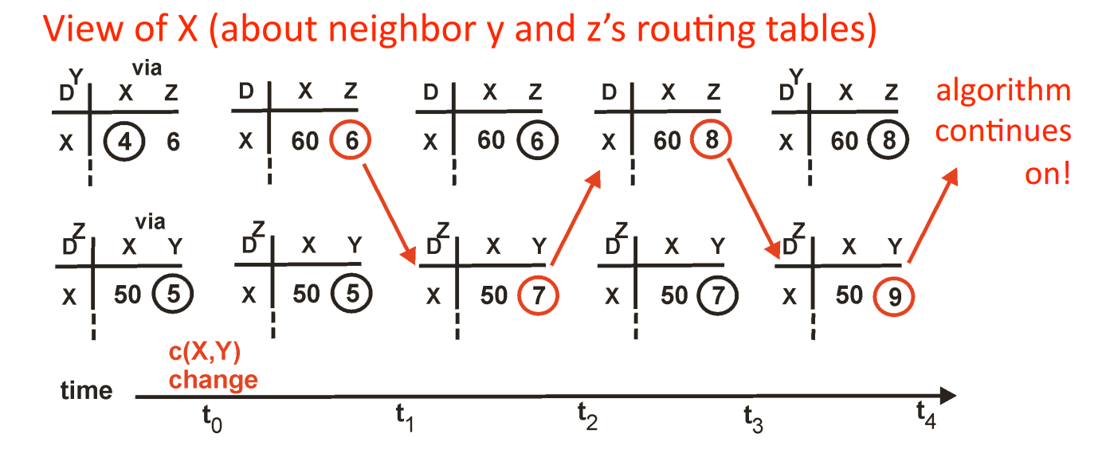
DistanZ-VeKtor Routing Protocol
60
“Bad news travel slow”:
“Count to infinity”-Problem:
y
4
1
x
z
50
Notes:
And why to bad news travel slow?

Slide 39
Internet Routing Protocol
Das Internet als Netzwerk von Netzwerken wird von unterschiedlichen Organisationen betrieben (Netzwerke werden Autonomes System genannt).
Daher sind Richtlinien beim Routing relevant!
Jedes Netzwerk nutzt unabhängig von den anderen ein internes Routing-Protokoll (“Intradomain” oder “Interior Gateway Protocol”).
Alle Netzwerke müssen ein gemeinsames (“Exterior-”) Interdomain-Protokoll unterstützen.
Ist dabei ein Link-State- oder ein Distanz-Vektor-Protokoll besser?

Slide 40
Internet Routing Protocol
Das Internet als Netzwerk von Netzwerken wird von unterschiedlichen Organisationen betrieben (Netzwerke werden Autonomes System genannt).
Daher sind Richtlinien beim Routing relevant!
Jedes Netzwerk nutzt unabhängig von den anderen ein internes Routing-Protokoll (“Intradomain” oder “Interior Gateway Protocol”).
Alle Netzwerke müssen ein gemeinsames (“Exterior-”) Interdomain-Protokoll unterstützen.
Ist dabei ein Link-State- oder ein Distanz-Vektor-Protokoll besser?
Link-State?
Jeder Router muss die gesamte Internet-Topologie kennen.
Keine Möglichkeit für Richtlinien!

Slide 41
Internet Routing Protocol
Das Internet als Netzwerk von Netzwerken wird von unterschiedlichen Organisationen betrieben (Netzwerke werden Autonomes System genannt).
Daher sind Richtlinien beim Routing relevant!
Jedes Netzwerk nutzt unabhängig von den anderen ein internes Routing-Protokoll (“Intradomain” oder “Interior Gateway Protocol”).
Alle Netzwerke müssen ein gemeinsames (“Exterior-”) Interdomain-Protokoll unterstützen.
Ist dabei ein Link-State- oder ein Distanz-Vektor-Protokoll besser?
Distanz-Vektor?
Dynamische Verteilung des kürzesten/günstigsten Pfades.
Auch keine Möglichkeit für Richtlinien!

Slide 42
Internet Routing - Inhalte
Geschichte des Internets
ARPANet
NSFNet
„Das Internet“
Internet Protocol
Wie Alice und Bob über das Internet kommunizieren
Netzwerk von Netzwerken (Autonome Systeme)
Netzwerk-Routing Protokolle
Border Gateway Protocol
Notes:
What today‘s lecture is about (Topic today: Internet Routing)
First, i would like to give a brief overview about the history of the Internet
It all began with the ARPANet, followed by the NSFSNet which led into the Internet as we know it today
Second, a short introduction or brush up (depending on your knowledge) about the Internet Protocol
Third, we are going to have a closer look how Alice and Bob might communicate utilizing the Internet.
Right after that a view on the technical structure of the Internet will be presented and how packet routing in networks work.
The brush-up then ends with the Border Gateway Protocol.

Slide 43
Border Gateway Protocol (BGP)
BGP is the Internet‘s de-facto standard interdomain routing protocol.
Allows policy base routing decisions such as:
Do not carry commercial traffic on educational networks.
Use the cheaper upstream provider even if the performance is bad.
For VoIP and Video stream use the expensive provider instead.
Do not route over the US to reach a partner also located in Germany! (US have Not Specified Adversaries, thank you Edward Snowden)
Policies allow a hierarchical routing system having providers, customers and peers.
Notes:
When it comes to interdomain routing, several networks‘ interests matter.
Routing policies are mostly proprietary.
Imagine possible routing policies for the shown figure:

Slide 44
Border Gateway Protocol (BGP)
AS D
AS A
AS B
AS C
X
Y
Z
Notes:
When it comes to interdomain routing, several networks‘ interests matter.
Routing policies are mostly proprietary.
Imagine possible routing policies for the shown figure:

Slide 45
InternetRouting mit BGP
Autonome Systeme annoncieren Erreichbarkeitsinformationen.
Ich bin AS 1234 und besitze IP-Adressen im Bereich 131.220.0.0/16
Accessnet
(ISP)
ISP A
131.220.240.100

Slide 46
InternetRouting mit BGP
Autonome Systeme annoncieren Erreichbarkeitsinformationen.
ISP A
ISP B
Ich bin AS 678 und ich bin verbunden mit AS 1234, mit dem IP-Adressbereich 131.220.0.0/16

Slide 47
InternetRouting mit BGP
Autonome Systeme annoncieren Erreichbarkeitsinformationen.
Ich bin AS 1535 und bin verbunden mit AS 678, das verbunden ist mit AS 1234, mit IPs aus 131.220.0.0/16
Accessnet
(ISP)
ISP B
74.100.129.53

Slide 48
InternetRouting mit BGP
Also wie kommt jetzt die Nachricht von Bob zu Alice?
…
…
…
…
…
…
131.220.240.100
74.100.129.53

Slide 49
InternetRouting mit BGP
Es kann dieser Pfad sein, ….
…
…
…
…
…
…
131.220.240.100
74.100.129.53

Slide 50
InternetRouting mit BGP
… oder dieser Pfad, … oder irgendein anderer (kreisfreier) Pfad.
…
…
…
…
…
…
131.220.240.100
74.100.129.53

Slide 51
Ende
Vielen Dank für die Aufmerksamkeit!
Fragen?
Nächste Vorlesung:
Montag, 16. Mai 2022
Nächste Übung:
Dienstag, 10. Mai 2022 – 16 Uhr
Abgabe des Übungszettels bis morgen – 16 Uhr

